Slide 1
Location, Asset, Date of incident
Incident details
PDO directorate/dept : (e.g. OSD _OSO_OSO4)
Incident owner : Name / Ref Ind
Location : Area / unit - (road/yard/station/rig/hoist/plant etc)
Incident date & time : (d/m/yr) / (24 hour clock) – advise if estimated
Incident type : Tier 1, Tier 2, HiPo,....
Actual severity rating : Number (1-5) / letter (P, E, A,R) – from RAM
Potential risk rating : Letter (A-E), Number (1-5)/letter (P, E, A,R) from RAM
Description of Event : One line description
Damage : Actual, Immediate cost and consequential
Names of any IPs : Names of the injured people (for fatality add marital statues with kids age)
PIM ID : Number assigned in PIM
Immediate cause : Short description of what caused harm
Key latent mgmt system failure: Key latent Mgmt failure from conclusion slide
Version 5.0

Slide 2
Location, Asset, Date of incident
Description of the incident:
Notes:
This should be free text writing and include the relevant facts explaining what happened to all the relevant parties in a short sharp factual paragraph that describes the incident
The description should be in sufficient detail to allow a person who does not know anything about the incident to imagine it. It should only be about what happened and not why it happened. Do not include investigation findings here, simply describe the incident as the investigation has shown it happened.

Slide 3
Location, Asset, Date of incident
Photographs, diagrams & sketches:
Notes:
Only include photos or sketches if they add value explaining the incident or causes.
Each photo/sketch must be labeled to explain what it is and why it has been shown.
Ensure photos are labeled to explain context (e.g. road looking in direction of; historical photo of plant before fire etc).
Ensure all photos are evidenced to the investigation. (have formed part of the investigation)
Ensure all photos are of suitable clarity.
Include a maximum of four photographs/sketches per page.
Do not exceed three pages of photographs, diagrams and sketches

Slide 4
Location, Asset, Date of incident
Key findings – Emergency Response & Damage
Notes:
Include details of Emergency response, effectiveness, exposure to staff, duration
Include estimate of environmental impact.
Include estimate of direct cost of the incident (immediate damage including replacement and clean up)
Include estimate of Indirect cost of incident. (shutdown, loss of production)

Slide 5
Location, Asset, Date of incident
Modeling Outcome/Incident Scenario

Slide 6
Location, Asset, Date of incident
Findings: Immediate causes:
Unsafe actions:
Immediate Cause Ref Nº # | ICAM Causation description | Justification for causation cited
Unsafe conditions:
Immediate Cause Ref Nº # | ICAM Causation description | Justification for causation cited
Notes:
Acts or conditions precipitating the incident. They usually involve the front-line staff, the consequences are immediate and can often be prevented by design, training or operating systems.
See listing in GU612 for immediate causes and their Ref Nº codes which must be used.
No free text allowed under descriptions, to be taken from ICAM document

Slide 7
Location, Asset, Date of incident
Findings: Underlying causes (human and workplace):
IC Ref Nº# | UC Ref Nº# | ICAM Causation Description | Justification for causation cited
Notes:
Underlying causes can be classified into two classes. Human factors & Workplace factors. They lead to the immediate causes i.e. they are the catalyst or pathway through which the immediate causes materialise.
No free text allowed under descriptions, to be taken from ICAM document

Slide 8
Location, Asset, Date of incident
Findings: Management system failures (MSF)
UC Ref Nº # | MSF Ref Nº # | ICAM Management Failure Description | Justification for management system failure cited
Notes:
What changes to the management system are needed to prevent a reoccurrence in the future across all sites. They are identified by asking what led to the underlying causes being allowed to exist.
No free text allowed under descriptions, to be taken from ICAM document

Slide 9
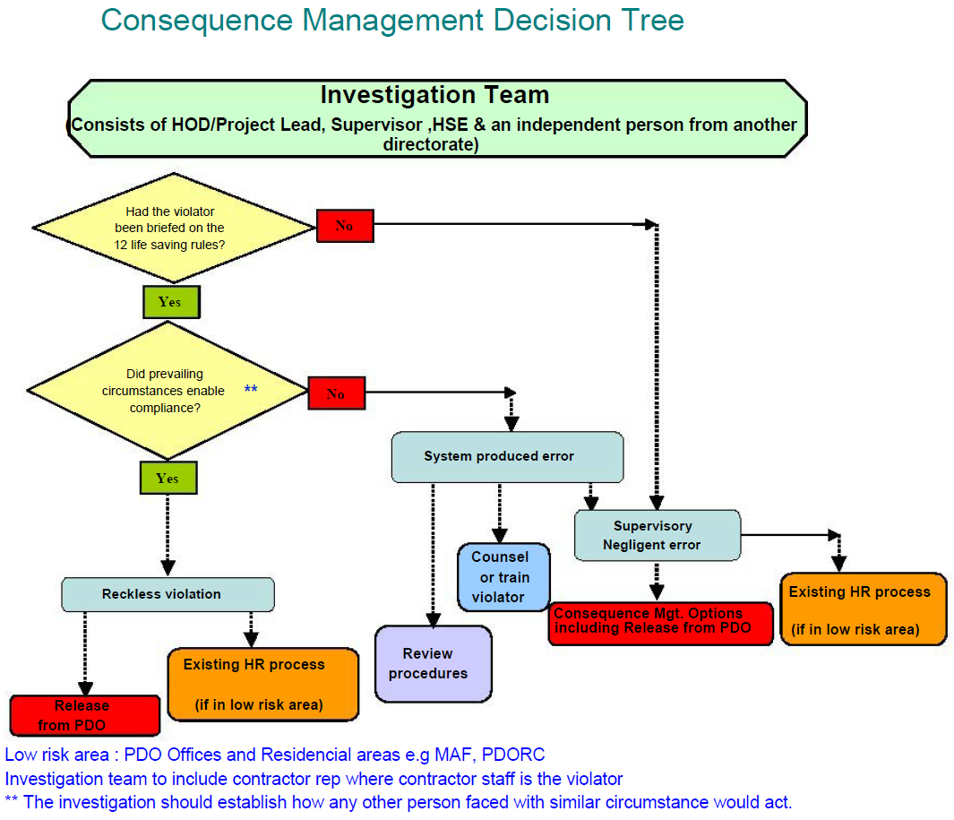
Location, Asset, Date of incident
Were life saving rule breaches related to the incident? - Yes / No?
Life Saving Rules
Delete which is not applicable
Who broke them? Names/Ref Inds: ………………………………….……..
Did the life saving rule breach, cause it? - Yes / No? Why……………………………………… .. ………………………………………………………………
Was it a reckless violation or negligent error? - Yes / No? Why……………………………………… ……………………………………………………………………………………………………………………………….
Which rule (s):
HR Panel
HOD/Project Lead, HSE & independent person from other directorate)
Is consequence management in PIM actions
Yes / No ?
If a contractor broke the rule has the Contract Holder been informed of the action taken?
Yes / No ?
Notes:
If Life Saving Rules were not relevant then delete the slide

Slide 10
PDO Contract management
Location, Asset, Date of incident
Report on the state of the contract management and whether any omissions were causational
No | Contract management process | Evidenced Y/N | Causational Y/N | Comments
1 | HEMP signed off by Contract Holder
2 | Annual HSE plan signed off and tracked by Contract Holder
3 | Monthly HSE meetings held with Contract Holder and actions recorded
4 | Tracking register for close out of HSE actions in place
5 | HSE audits, inspections , site visits conducted as per plan
6 | HSE competency assured in review of HSE training matrix
7 | HSE VTCs implemented correctly
8 | HSE procedural step-outs managed effectively
9 | Evidence of MOC being effectively managed by Contract Holder
10 | Evidence of HSE defaults for non compliances

Slide 11
Location, Asset, Date of incident
Barrier Broken / Missing
e.g. Piping Systems
e.g. Manually Overridden
Structural
Structural
Structural
Structural
Process
Process
Process
Integrity
Process
Integrity
Integrity
Integrity
Containment
Containment
Containment
Containment
Ignition
Ignition
Ignition
Ignition
Control
Control
Control
Control
Detection
Detection
Detection
Detection
Systems
Systems
Systems
Systems
Protection
Protection
Protection
Protection
Systems
Systems
Systems
Systems
Shutdown
Systems
Emergency
Emergency
Emergency
Emergency
Response
Response
Response
Response
Life
Life
Life
Life
Saving
Saving
Saving
Saving
- Competency Issue
- Procedure Adherence

Slide 12
Location, Asset, Date of incident
Immediate actions taken:
 | Actions taken | Date | Action party PDO / contractor
1 | Review HEMP for appropriateness in regards to the incident, is it used, how is it translated into action, last review date
2
3
4
5
6
7
Notes:
Immediate actions taken include all those reported to have been taken and completed within one week of the incident in a table. The first action is mandatory and cannot be deleted.
Report the five most important remedial actions to prevent a reoccurrence in the future. These may be tracked for completion by the MSE team and reported to MDIRC. They should be the most important remedial actions in stopping the incident reoccurring.

Slide 13
Location, Asset, Date of incident
Remedial actions planned:
 | Remedial actions planned | LMSF Causation number | Target date | Contractor action party | PDO action party for PIM
1
2
3
4
5
6
7
Notes:
Report the most important remedial actions to prevent a reoccurrence in the future first, these may be tracked for completion by the MSE team and reported to MDIRC. They should be the most important remedial actions in stopping the incident reoccurring.
Essential actions planned or recommended that require directorate or MD approval should be on next slide
Once actions are completed move to previous action taken slide

Slide 14
Location, Asset, Date of incident
Recommendations for MDIRC/IRC endorsement:
.
Recommendation Nº 01 |  | Status | Endorsed/Not endorsed
Causations No
Recommendation
Action party | Reference Ind. | Target date
Revised recommendation after IRC review
Recommendation Nº 02 |  | Status | Endorsed/Not endorsed
Causations No
Recommendation
Action party | Reference Ind. | Target date
Revised recommendation after IRC review

Slide 15
Location, Asset, Date of incident
Incident Review Committee
Contractor Commitment Declaration
I, Mr. …………………………….…………………. CEO, and
I, Mr. ………………………………………………. Operations Manager
Of the Company: ………………………………….
We have signed below to demonstrate to PDO our commitment to personally conduct the necessary follow up to ensure the effective implementation of the agreed actions contained in the IRC endorsed investigation in all our units, and to demonstrate our personal leadership in implementing the necessary consequence management in case of re-occurring of similar incident.
Moreover, we will disseminate the learning from this incident to all our workforce and our subcontractors.
Mr. …………………… Signature:………………………… Date:………………..
Mr. …………………… Signature:………………………… Date:………………..
Notes:
One of the most important additions to the new process is the contractor commitment sign off
Here the CEO or senior manager agrees their commitment in writing in front of the PDO Director or MD stating that they will ensure all actions are implemented, contract holder informed for PIM closeout and that they will show adequate leadership to improve safety and prevent a re-occurrence
They also agree to pass on the learning's to their workforce and sub-contractors

Slide 16
Location, Asset, Date of incident
Sequence of events/timeline
..
..
..
..
Notes:
You can use any format for a time line, or sequence of events, e.g. a list, a diagram or tables, which ever you believe best fits your investigation.
Only include events which are key to explaining what happened.

Slide 17
Location, Asset, Date of Incident
Tripod Tree
(include copy of the Tripod tree flow diagram for all
4/5 incidents or High Potential)
Investigation reports requiring a Tripod must confirm that the findings and recommendations match the Tripod findings

Slide 18
Location, Asset, Date of Incident
Supplementary investigation findings:
The findings are points to note but were not causational in the incident
People,
training, age, experience, nationality, medical conditions, disciplinary record etc
Equipment,
type, serial number, maintenance, inspection, failings, appropriate for use etc
Activities at the time of the incident,
lifting, driving, commuting, drilling, POOH etc
Relevant environment,
workplace conditions, weather, lighting, floor surface, dust, cramped etc
Operational management ,
supervision, TBTs, SJPs, SWPs, STOP, availability on site etc
Contractual management,
audits, CH involvement, defaults, inspections, visits, issues, sub contractor management
HEMP,
review, appropriateness to the incident, is it used, how is it translated into action
Previous relevant incidents/learnings,
what, where, were they aware of it, were controls introduced

Slide 19
PDO Second Alert
Date: Incident title
What happened?
Short description of what happened
Your learning from this incident..
(This must solely relate to the people at risk of harm or people at risk of causing the harm)
Learning points for them from the investigation
Photo explaining what was done wrong
Photo explaining how it should be done right
Strap line – should be the key (keep short and memorable )

Slide 20
Management self audit
Date: Incident title
As a learning from this incident and ensure continual improvement all contract
managers must review their HSE HEMP against the questions asked below
Confirm the following:
1
2
3
4
5
Notes:
Make a list of closed questions (only ‘yes’ or ‘no’ as an answer) to ask other contractors if they have the same issues based on the management or HSE-MS failings or shortfalls identified in the investigation. Pretend you have to audit other companies to see if they could have the same issues.

